Slide 1
Web Design Fundamentals /
Basic Web Design
Linking Pages, Images, Tables – ITEWEBDES

Slide 2
CREATING LINKS

Slide 3
Anchor Tag <A> <a>
A tag that identifies a link or a location within a document that creates hyperlink using HREF = attribute.
Ex:
<A HREF="http://www.feu.com> Visit FEU </A>
<a href="http://www.feu.com> Visit FEU </a>

Slide 4
Attribute Information
HREF="URL”
Specifies the relative or absolute location of a file to which you want to provide a hyperlink.
Absolute URL - points to another web site
(like href="http://www.example.com/theme.css")
Relative URL - points to a file within a web site
(like href="/themes/theme.css")

Slide 5
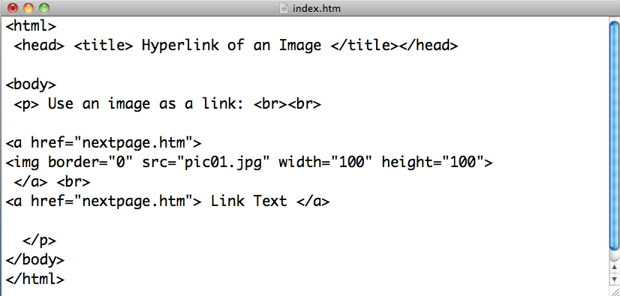
HTML Link with Image
Make a hyperlink of an image and text.
a. Create a folder inside the main folder ITEWEBDES_section.
b. Foldername: surnameImageLink
b. Open notepad++, create two .html file.
1. index.html
2. nextpage.html
c. Save any image. Filename: pic01.jpg

Slide 6
Adding images to the body content either static images, animated icons, pictures, drawing illustration can make documents more attractive, inviting, professionally looking, informative and easy to browse.

Slide 7
There is also a special feature for adding images for it to become visual map of hyperlinks.
Disadvantage is, it would lengthen the time it takes for users to download pages.

Slide 8
There is no prescribed format for images to be used in web.
However most popular browsers accommodate certain images like GIF, PNG, and JPEG.
Other formats requires special applications to be installed to view special files.

Slide 9
WEB OUTPUT
FILE FORMAT | WHEN TO USE
JPEG (Joint Photographic Experts Group) | Commonly used for graphics that include a wide range of colors, like photos. It compresses images so they take up less space, but the smaller file size comes at a price: loss of quality.
GIF (graphics interchange format) | Use GIF for images with solid blocks of color. If you’re dealing with line art or images made from areas of solid color (logos, comic strips, and so on).
PNG (Portable Network Graphics) | Use PNG for super high-quality files. If quality is more important than download speed, save your image as a PNG. It also offers true transparency and better image quality than a JPEG, but it generates larger files.
WBMP (Wireless Bitmap) | Use for black-and-white images headed for mobile devices. If you’re designing black-and-white images for handheld devices (cell-phones, smart phones, and so on), choose WBMP.

Slide 10
Inserting Image
<html>
<head> <title> Adding Images </title> </head>
<body>
<img src="samplepic.jpg" width="90" height="90"> <br>
<img src="samplepic.jpg">
</body>
</html>

Slide 11
<img> tag src attribute
The <img> tag is empty, which means that it contains attributes only, and has no closing tag.
Src stands for "source". The value of the src attribute is the URL of the image you want to display.
<img src=“picture.jpg”>

Slide 12
<img> tag alt attribute
The required alt attribute specifies an alternate text for an image, if the image cannot be displayed.
<img src=“picture.jpg” alt=“This is sample picture”>

Slide 13
<img> tag title attribute
Provides a balloon text whenever the mouse pointer is hovered over the image
<img src=“picture.jpg” title=“This is sample picture”>

Slide 14
<img> tag height and width attribute
The height and width attributes are used to specify the height and width of an image in pixels.
<img src=“picture.jpg” alt=“This is sample picture” height=“30” width=“30”>

Slide 15
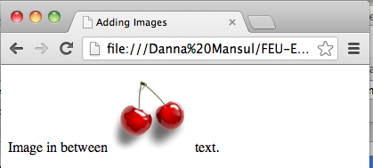
INLINE IMAGES IN HTML
It can be inserted within HTML document using an empty tag <img>
IMAGES IN BETWEEN TEXT
Images can be displayed among text in HTML document.
Image in between <img src=“picture.jpg” alt=“This is sample picture” > text

Slide 16
IMAGES AND LINKS
Put <img> tag inside <a> tag for it to become an image link.
BACKGROUND IMAGE
You may also place an image into the background of a document with attribute in the <body> tag.
<body background=“sample.jpg”>
</body>

Slide 17
<table>

Slide 18
Creating Basic Tables
Tables are collections of rows and columns that you use to organize and display data
In a table, the intersection of any given row and column is called a cell.
Tables are also used to lay out Web pages, much like frames have been used

Slide 19
Basic <table> Elements
You create tables using the <table> element. Within the <table> element you can nest a number of other elements that specify the content of each cell along with the structure and appearance of the table. The <table> element also includes several attributes that affect the appearance and structure of a table.

Slide 20
<table> Element
Specifies a container for a table within your document.
Inside these tags you can place
<tr>, <td>, <th>, <caption>, and other <table> tags.

Slide 21
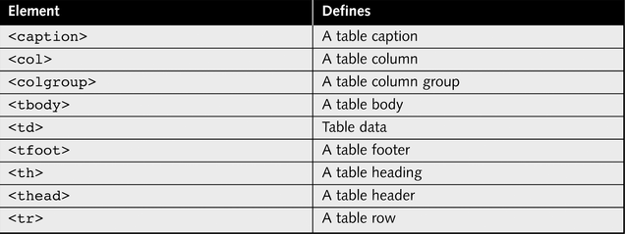
Table Elements

Slide 22
The <td> Element
Cells are the most basic parts of a table
You create a cell within the <table> element using the <td> element
The <td> element stands for “table data”
The content of each <td> element is the data that will appear in the table cell

Slide 23
<th> Element
The <th> tag defines a header cell in an HTML table.
Header cells - contains header information (created with the <th> element)
The text in a <th> element is bold and centered.

Slide 24
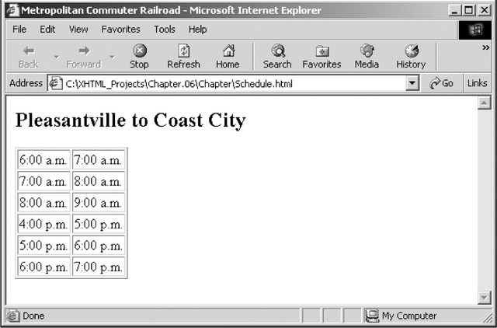
Schedule Table

Slide 25
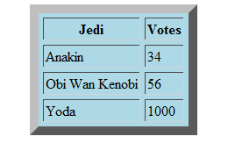
<html>
<head>
<title>TABLES </title>
<body>
<table border=“10” cellspacing="7" bgcolor="#99CCFF" >
<tr>
<th>Jedi</th>
<th>Votes </th>
</tr>
<tr>
<td>Anakin</td>
<td>34</td>
</tr>
<tr>
<td>Obi Wan Kenobi</td>
<td>56</td>
</tr>
<tr>
<td>Yoda</td>
<td>1000</td>
</tr>
</table>
</head>
</html>
Try this:
NOTE: for easier reading
<tr> = rows
<th> or <td> = columns

Slide 26
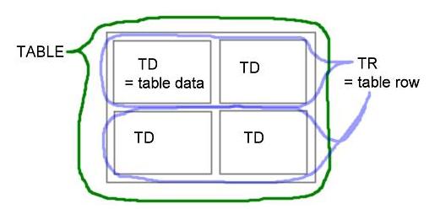

Slide 27
Caption
Most tables include a caption that describes the data in the table
You create a caption for a Web page table using the <caption> element
The <caption> element must be the first element following the <table> element, and you can include only a single <caption> element per table
A caption should provide a short phrase or title that clearly describes the contents of the table

Slide 28
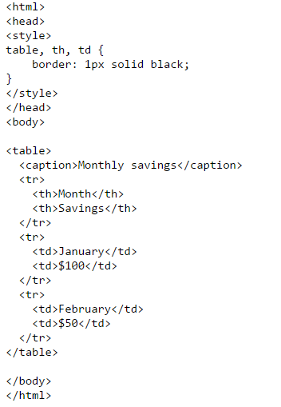
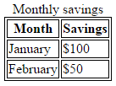
Caption
Note:
The <caption> tag must be inserted immediately after the <table> tag.
You can specify only one caption per table.

Slide 29
Table Widths
You use the width attribute of the <table> element to specify the size of a table
You can assign a fixed value in pixels or a percentage representing the visible width of a Web browser window

Slide 30
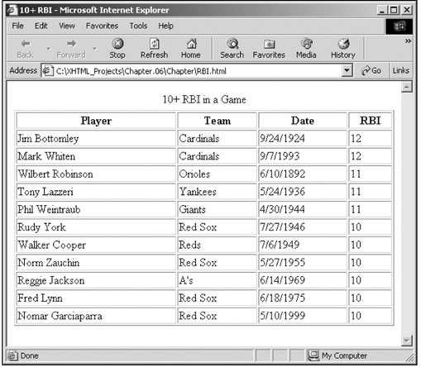

Slide 31
Horizontal Alignment
You can use the align attribute to adjust the horizontal alignment of the contents of all table elements with the exception of the <table> and <caption> elements
The values you can assign to the align attribute are left, center, right, and justify

Slide 32
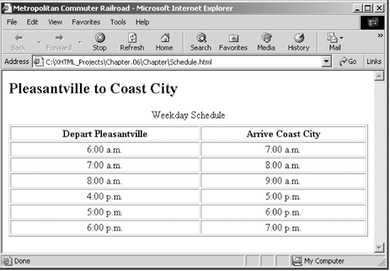

Horizontal Alignment

Slide 33
Borders
You use the <table> element’s border attribute to add a border to a table
The value you assign to the border attribute determines the thickness of the border in pixels

Slide 34
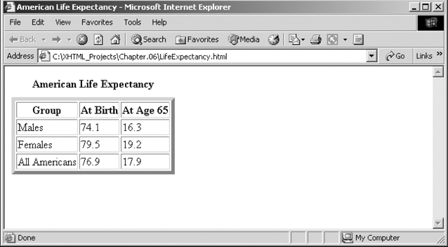

Slide 35
Displaying Empty Cells
Web browsers do not render the borders around empty cells
To fix this problem, you need to add a <td> element for each empty cell, and include a non-breaking space character entity (&nbsp;) as each cell’s content

Slide 36
Cell Margins
The cellspacing attribute specifies the amount of horizontal and vertical space between table cells
You assign to the cellspacing attribute a value representing the number of pixels that you want between table cells
In comparison, the cellpadding attribute specifies the amount of horizontal and vertical space between each cell’s border and the contents of the cell

Slide 37
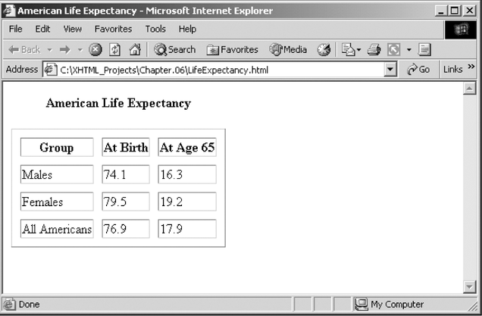
Cell Margins

Slide 38
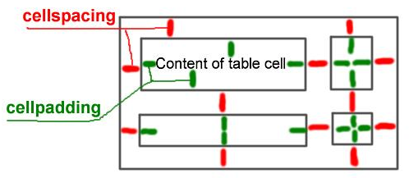
The Attributes CELLPADDING and CELLSPACING
The attribute CELLPADDING describes the space in pixels between a table cell´s border and its content.
The attribute CELLSPACING describes the space in pixels between the different table cells.

Slide 39

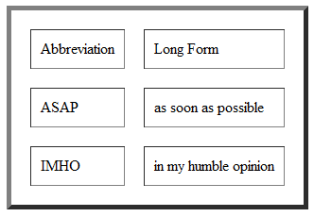

Slide 40
Understanding rowspan and colspan:
Table cells can span across more than one column or row.
The attributes COLSPAN ("how many across") and ROWSPAN ("how many down") indicate how many columns or rows a cell should take up.

Slide 41
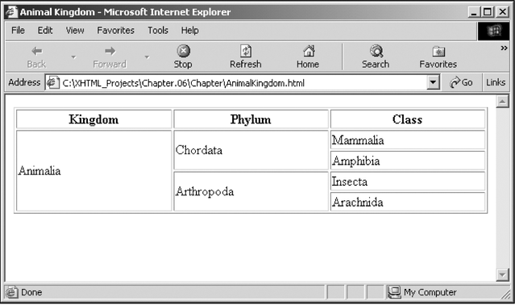

Slide 42
rowspan
Row Span extends cells on a vertical row (up and down). The line to add for Row Span is ROWSPAN="X". This line adds onto the <TD> cell

Slide 43


<html>
<head>
<title>My Homepage</title>
</head>
<body>
<table border="1">
<tr>
<td rowspan="2">CELL 1 </td>
<td> Cell 2 </td>
</tr>
<tr>
<td> Cell 3 </td>
</tr>
</table>
</body>
</html>
Without spanning:

Slide 44
colspan
Column Span extends cells on a horizontal row (left and right). The line to add for Column Span is colspan="X". This line adds onto the <TD> cell.

Slide 45

<html>
<head>
<title>My Homepage</title>
</head>
<body>
<table border="1">
<tr>
<td>CELL 1 </td>
<td> Cell 2 </td>
</tr>
<tr>
<td colspan="2"> Cell 3 </td>
</tr>
</table>
</body>
</html>

Slide 46
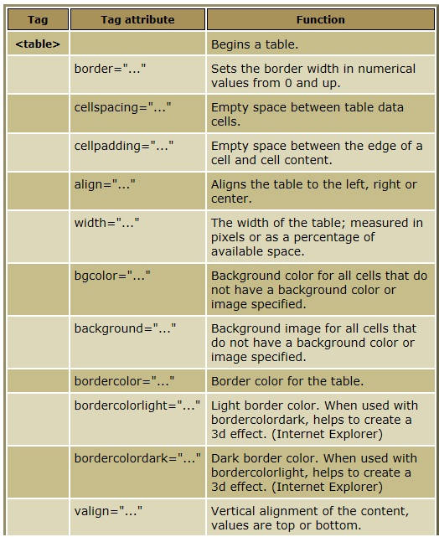

Slide 47
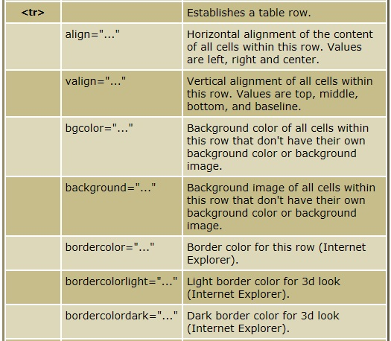

Slide 48
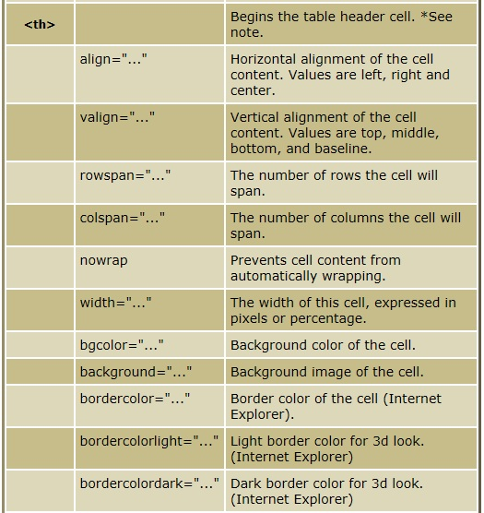

Slide 49
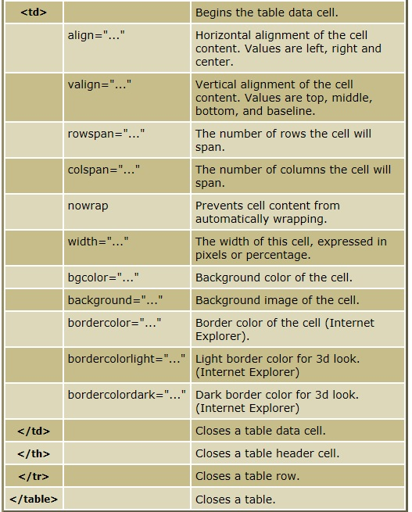

Slide 50
HTML TABLE ACTIVITY:
rowspan – how many down
colspan – how many acrosss

Slide 51
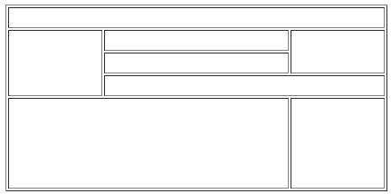
HTML TABLE HANDS-ON QUIZ:
1. 25 points
1 2 3 4
1
2
3
4
5
6
7
8
9
rowspan – how many down
colspan – how many acrosss

Slide 52
HTML TABLE HANDS-ON QUIZ:
2. 25 points
1 2 3 4
1
2
3

Slide 53
End of Module

